Slide 1

SAMHSA Primary Behavioral Health Care Integration Grantee Annual Meeting
September 25, 2013
Population Management for Co-Occurring Diabetes and Mental Illness
Implementing a Registry to Increase Adherence to
Diabetes Standards of Care
Jessica A. Jonikas, M.A. & Judith A. Cook, Ph.D.
UIC Center on Psychiatric Disability & Co-Occurring Medical Conditions

Slide 2

Today’s Presentation
Diabetes as a public health crisis
UIC Diabetes Care Coordination & Registry Study
Registry review; Diabetes Standards of Care
The case for registries: benefits and evidence
Registry platforms and content
Using a registry to support population management and self-management
Considering key barriers

Slide 3

With thanks to our funders
U.S. Department of Education, National Institute on Disability & Rehabilitation Research
Substance Abuse & Mental Health Services Administration, Center for Mental Health Services
    Cooperative Agreement #H133G100028

Slide 4
A Public Health Crisis
People in recovery have a higher prevalence of diabetes:
lifestyle factors
psychiatric medications that cause blood sugar disorders
complicated illness
  - doctors & patients often unsure of what’s behind poorly controlled glucose
People with diabetes are at-risk for developing:
Hypertension
Hyperlipidemia
Heart disease
Kidney disease
Gum disease/loss of teeth
Nerve damage/loss of feet
Eye disease/becoming blind
Costs are 2.4 times greater; nearly 40% of costs due to long-term complications!

Slide 5

Use of a Registry to Manage Care for Diabetes in Integrated Health Clinics for Adults with Serious Mental Illnesses
Judith A. Cook, PhD, Principal Investigator
Introduce a diabetes registry to:
Improve care delivery
    full adherence to ADA standards of care
    develop new treatment & service resources
Enrich care coordination
    link clients to needed specialty care in accordance with ADA standards
    teach clients about diabetes and its complications
    introduce new client engagement activities
Better monitor health indicators and outcomes over time

Slide 6
What is a Diabetes Registry?
An electronic database used to manage care delivery and outcomes for people with a given disease
  Background characteristics, illness characteristics, treatment, specialty care
Information is compiled from either paper or electronic medical records, or both
Can be used at the clinic, system, or population level
A population-based registry contains records for people who reside in a defined geographic region (state, county, country)
Overall goal is to improve population health by tracking key indicators

Slide 7
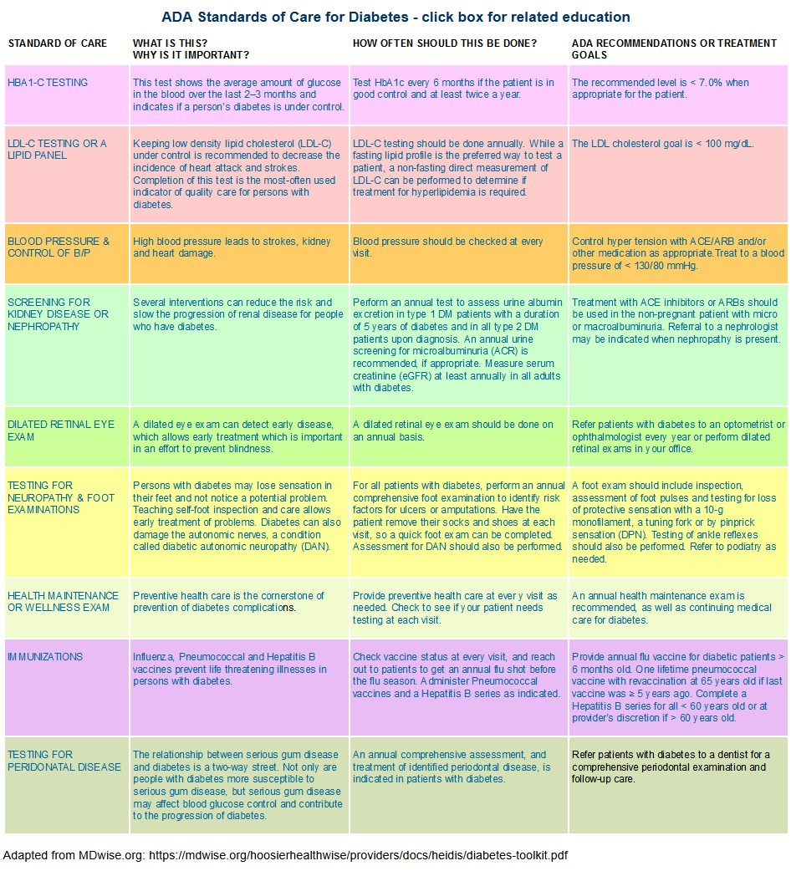

Slide 8
Sample Standards Tracked in Diabetes Registries for Individual & Population Management
Standard | Target
Blood Glucose (HbA1c) | Less than 7%
Blood Pressure | Less Than 140/90 mmHg
LDL cholesterol | Less Than 100 mg/dl
Urine Screening for Microalbumin | Annual screening
Dilated eye exam | Annual screening
Foot exam for neuropathy | Annual screening
Dental exam | Annual screening
Vaccinations | Lifetime and annual

Slide 9
What else is in a diabetes registry?
Client demographics
Practice, clinic, other
administrative identifiers
Test results and dates
  Glucose, eye exam, foot exam, dental exam
Out of range values and risk factors
  BMI, glucose, blood pressure, lipids, triglycerides, nicotine
Medications
Vaccinations
Co-morbidities
Color-coding feature
to identify out-of-
range values

Slide 10

Take Note!
Plan to build in capability to update registry content as care standards change

Slide 11
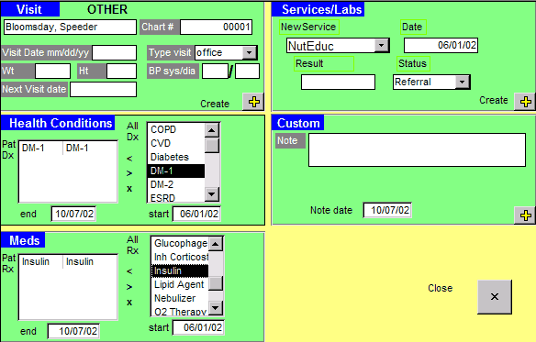
Why Registries for Standards of Care?
One electronic database contains data from multiple sources to inform complex disease processes
Quickly focuses effort on better managing chronic disease at population level
Can be used by multiple parties (clinicians, patients, administrators) to facilitate care delivery while meeting care standards
(Ortiz, 2006)

Slide 12
Registries and Patient-Centered Care
Allows clients to see their test results related to 1 or more conditions all in one place
Permits clients to share current results with specialists and other providers for safer/better care coordination and outcomes
Helps clients track their own results over time, assess personal improvements, and identify areas of concern
Enables clients to compare their test results and health outcomes with those of peers or the general population

Slide 13
Why Registries for Care Coordination?
Allows for identification and monitoring of clients with a specific need within a clinic or across clinics
Fosters individual disease management through notifications of abnormal test results, missed appointments, and up-to-date information on client encounters
Puts the focus on the needs and progress of high-risk clients to manage limited resources (client & clinic)
Promotes use of evidence-based and values-driven care
Facilitates health outcomes management at both the individual and clinic levels
(Hummel, 2000)

Slide 14

“A physician who opens the chart may see that the patient’s blood sugar is up. But that doesn’t tell the clinician that out of 200 patients with diabetes, 10 are out of control.”
Iowa Department of Public Health
Disease Registry Issue Brief, 2010

Slide 15
“Rapid improvement in any field requires measuring results… Teams improve and excel by tracking progress over time and comparing their performance to that of peers inside and outside their organization. Indeed, rigorous measurement of value (outcomes and costs) is perhaps the single most important step in improving health care. Wherever we see systematic measurement of results in health care - no matter what the country - we see those results improve.
Yet the reality is that the great majority of health care providers fail to track either outcomes or costs by medical condition for individual patients.”
Porter & Lee, 2013
Harvard Business Review

Slide 16
Population Studies using a Diabetes Registry
Improving Diabetes Care in a Large Health Care System:
An Enhanced Primary Care Approach
Sperl-Hillen, et al. (2000). Joint Commission Journal on Quality and Patient Safety
  Improved glycemic and lipid control among approximately 7,000 adults with diabetes.
The Impact of Planned Care and a Diabetes Electronic Management System on Community-Based Diabetes Care:
The Mayo Health System Diabetes Translation Project
Montori et al. (2002). Diabetes Care.
  Registry use augmented the impact of planned care on performance outcomes (increased use of specialty medical care) and certain metabolic outcomes. Did not impact glucose levels.

Slide 17

Diabetes Registries: Across Clinics
Improving Diabetes Outcomes Using a Web-Based Registry and Interactive Education: A Multisite Collaborative Approach
Morrow, R. et al., (2013). Journal of Continuing Education in the Health Professions
  Electronic diabetes registry in 7 clinics in NY
  With educational module on the registry and patient communication
Patients were:
  1.4 times more likely to have A1C ≤ 9
  Almost twice as likely to have LDL < 100
  1.3 times more likely to have BP < 140/90

Slide 18
Diabetes Registries: At the Clinic Level
Impact of a Diabetes Electronic Management System on Patient Care in a Community Clinic
East, J. (2003). American Journal of Medical Quality
82 patients at a community clinic (managed in a registry) compared to 63 patients in same practice group (outside of the registry)
Significant increases in percentage of registry patients receiving evidenced-based care. None observed in comparison group.
    serum creatinine, lipid, and hemoglobin A1C tests
    foot and retinal examinations
    patient establishment of self-management goals

Slide 19
Diabetes Registries: Clinic Level (cont.)
East, 2003:
Overall completion of evidence-based care processes increased by 26% in the intervention group
  3% of the time in the comparison group
Adherence to care standards occurred 82% of the time in the intervention group
  51% of the time in the comparison group

Slide 20
Okay, but why not just use an Electronic Health Record?
Most EHRs are not built to function as registries, so can’t support population-based care
It can take years (if ever) for system-wide reporting from an EHR
A registry is relatively easy and inexpensive
  Can have nearly immediate impact on clinic practice and client engagement & outcomes
It can be instructive to learn population-based care parameters prior to implementing an EHR via a registry
  Allows you to design EHR processes to support needs identified by registry use
Content adapted from:
www.powershow.com/view/21d14-MzEyZ/Using_Excel_for_a_HgA1c_Registry_powerpoint_ppt_presentation

Slide 21
Comparing the Options
Disease Registry
Inexpensive
Easier to implement
Focuses effort on specific medical needs/risks
Engages the client
Promotes standard of care & coordination
Low risk
Can be extended to other medical conditions
EHR
Costly
Harder to implement
Can mimic flawed care processes
Little client involvement
Broader QI harder to implement
High risk
Often a poor registry for medical conditions
Content adapted from:
www.powershow.com/view/21d14-MzEyZ/Using_Excel_for_a_HgA1c_Registry_powerpoint_ppt_presentation

Slide 22
Platform Options
CareMeasures
www.caremeasures.org/CareMeasures/public/Default.aspx
Easy to use & customize
Manages multiple conditions
Must register & pay fees
Excel
http://www.aafp.org/fpm/2006/0400/p47.html
Free software and template
Easy to learn and implement
  - Storing only the most
  recent results
Good for population management of single disease
CDEMS
cdems.com
Good, free program!
Challenging to learn and implement
Technical support no longer available
Doc Site portal.covisint.com/web/supporthc/ccahc
Annual per provider fee
Web-based; easy to access
Can role up nationally
Content adapted from:
www.powershow.com/view/21d14-MzEyZ/Using_Excel_for_a_HgA1c_Registry_powerpoint_ppt_presentation

Slide 23
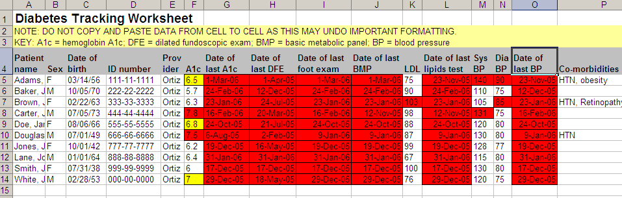
www.aafp.org/fpm/2006/0400/p47.html

Slide 24
Population Management via Reports
Client Last Name | Client Birthdate | Provider | Value of most recent A1C | Date of most recent A1C
Ryan | 03/31/40 |  | 9.8 | 09/05/2013
Bell | 05/25/72 |  | 8.9 | 02/18/2012
Cruz | 06/16/60 |  | 7.8 | 06/17/2012
Smith | 01/15/65 |  | 7.1 | 08/15/2013
Ramirez | 05/24/61 |  | 6.5 | 08/01/2012
Jordan | 09/12/60 |  | 6.5 | 09/12/2012
Stock | 10/10/80 |  | 6.2 | 07/13/2013
Blake | 12/12/40 |  | 5.2 | 05/14/2013
Bergman | 11/12/61 |  | 5.0 | 05/05/2013
Sort by test value to determine who is most at risk

Slide 25
Care Coordination via Reports
Client Last Name | Client Birthdate | Provider | Date of most recent eye exam
Bell | 05/25/72 |  | 11/11/2011
Cruz | 06/16/60 |  | 06/10/2012
Ramirez | 05/24/61 |  | 04/15/2012
Jordan | 09/12/60 |  | 02/17/2012
Smith | 01/15/65 |  | 09/05/2012
Ryan | 03/31/40 |  | 09/15/2012
Stock | 10/10/80 |  | 04/13/2013
Bergman | 11/12/61 |  | 03/05/2013
Blake | 12/12/40 |  | 02/14/2013
Sort by test date to determine who is overdue and needs care coordination

Slide 26
Care Coordination via a Birthday Letter
Registry information used to generate personalized letters for patients with concerning values.
Here’s an example from a VA in OH of reaching out to patients on cholesterol results.
Underlined text is inserted using expert logic.
Cleveland VA July 27, 2007
Dear JOHN DOE,
Happy Birthday! Your VA health care providers want you to have many more!
We are sending you your latest diabetes test results because our VA records show that your blood test for cholesterol is either too high, or needs to be rechecked.
Your LDL-cholesterol (the ‘bad’ kind of cholesterol) should be less than 100 to protect you from stroke or heart attack. Even if your last test was good, you are due to have it checked again.
Your primary provider at the VA Lorain clinic would like you to call L W to go over your results, set up a fasting blood test, or set up a visit.
Please call (440) 244-3833 EXT 2247 to schedule. If you come for a clinic visit, please bring in all of your medication bottles, your blood glucose meter, and any glucose records if you have them. Thanks!

Slide 27
Performance Management via Reports
Client Last Name | Client Birthdate | Provider | Value of most recent A1C | Date of most recent A1C
Ryan | 03/31/40 | Dr. S | 9.8 | 09/05/2013
Smith | 01/15/65 | Dr. S | 7.1 | 08/15/2013
Ramirez | 05/24/61 | Dr. S | 6.5 | 08/01/2012
Jordan | 09/12/60 | Dr. S | 6.5 | 09/12/2012
Bell | 05/25/72 | Dr. A | 8.9 | 02/18/2012
Cruz | 06/16/60 | Dr. A | 7.8 | 06/17/2012
Stock | 10/10/80 | Dr. A | 6.2 | 07/13/2013
Blake | 12/12/40 | Dr. A | 5.2 | 05/14/2013
Bergman | 11/12/61 | Dr. A | 5.0 | 05/05/2013
Sort by provider then value to identify performance goals

Slide 28
At our Center: Registry Reports for Self-Management

Slide 29
Pros of Excel Cons of Excel
Easy to learn
Good visual cues
Ease of data entry & data cleaning
System stability
Ability to interact with the data
Not automated: can be labor- and time-intensive (especially if tracking multiple values and dates)
Unwieldy for multiple diseases
  Single or different spreadsheets for multiple conditions?

Slide 30
Getting Started
Identify clients with diabetes
  ~From clinic, billing, or lab systems
~Lab systems have the advantage of giving test
values and dates
Set up registry in Excel
~Pre-load one year’s worth of data
~Start small with just one indicator (e.g., A1c)
Add data as indicators are checked, tests are
performed, or referrals are arranged
~Can write over any pre-existing data (save
only the last value)

Slide 31
Keep it Simple!
Monthly
  Sort Excel by patient then test results and date
  Give list of patients out-of-range and/or overdue for key tests to care coordinator and/or clinicians
  Send letters to patients (calls good too!)
    Start with 5/month or by birthdays
Quarterly
  Sort Excel by provider, test values, and test dates
  Give to supervising clinician to address performance goals at provider and clinic level
As scheduled
    Meet with patients to give them personalized reports and review self-management goals
Content adapted from:
www.powershowom/view/21d14-MzEyZ/Using_Excel_for_a_HgA1c_Registry_powerpoint_ppt_presentation

Slide 32
What are some key barriers?
Shifting from reaction to prevention
Moving from individual level to population-based care
Getting multiple partners invested
Time to load and maintain the spreadsheet or database
Measuring performance can be threatening
Just another fad?
Content adapted from:
www.powershow.com/view/21d14-MzEyZ/Using_Excel_for_a_HgA1c_Registry_powerpoint_ppt_presentation

Slide 33

To Reach Us…
Visit our website
www.cmhsrp.uic.edu/health/index.asp
Learn about our registry study
www.cmhsrp.uic.edu/health/medical_home_registry.asp

